Slide 1
Containerization & Orchestration for Deep Learning
Using Dockers & Kubernetes
-Akshay Shanbhag

Slide 2
Topics of discussion
Theory
Instructions
Problems with traditional ML training & deployment
Containerization
Docker Architecture
Docker Components
Orchestration
Kubernetes Architecture
Scaling up with Kubernetes- Application Deployment
Nvidia Container toolkit for GPU Training
Multi-GPU Training on PyTorch
Automatic Scaling up of models on GPUs using PyTorch Lightning
Setting up and running a docker container to train a CNN model
Adding GPU Configuration using Nvidia Container Toolkit

Slide 3
Problem with traditional ML Deployment
Need to install dependencies on every machine
Bringing the ML pipeline into production is time consuming and stressful
(only 22% of those companies who plan to use ML actually use them)
Computing resource utilization and scalability is another challenge.

Slide 4

Is there a Solution??

Slide 5
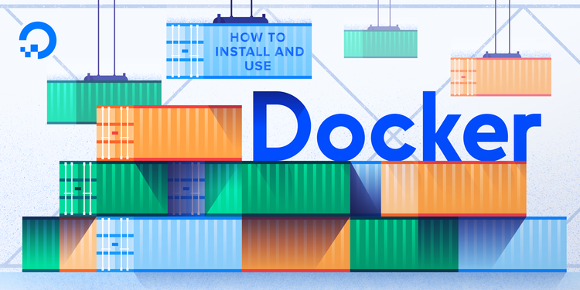
Containerization

Slide 6
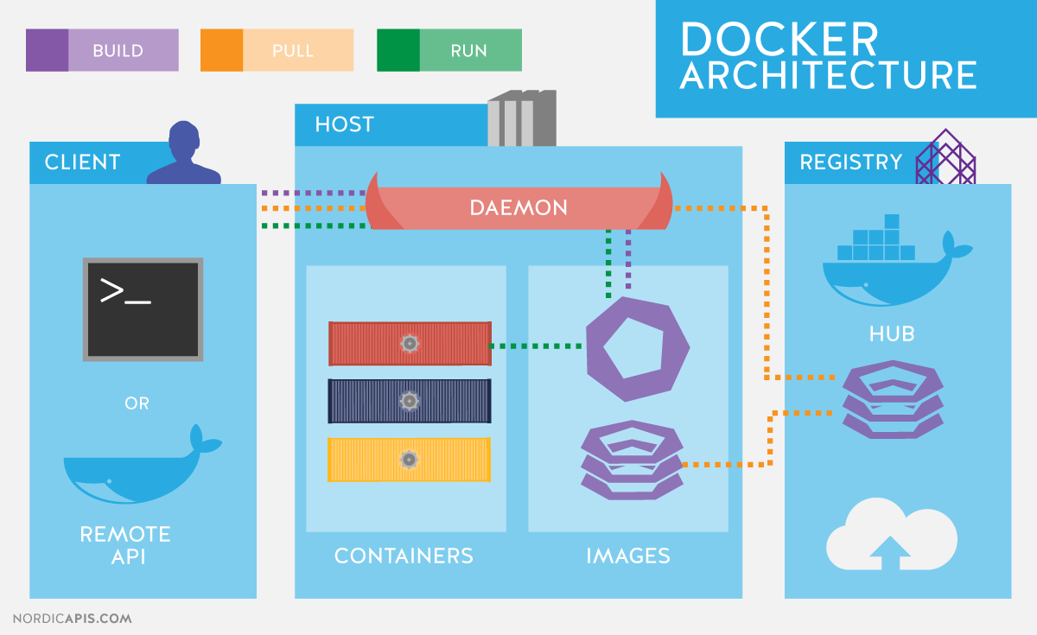
Docker Architecture

Slide 7
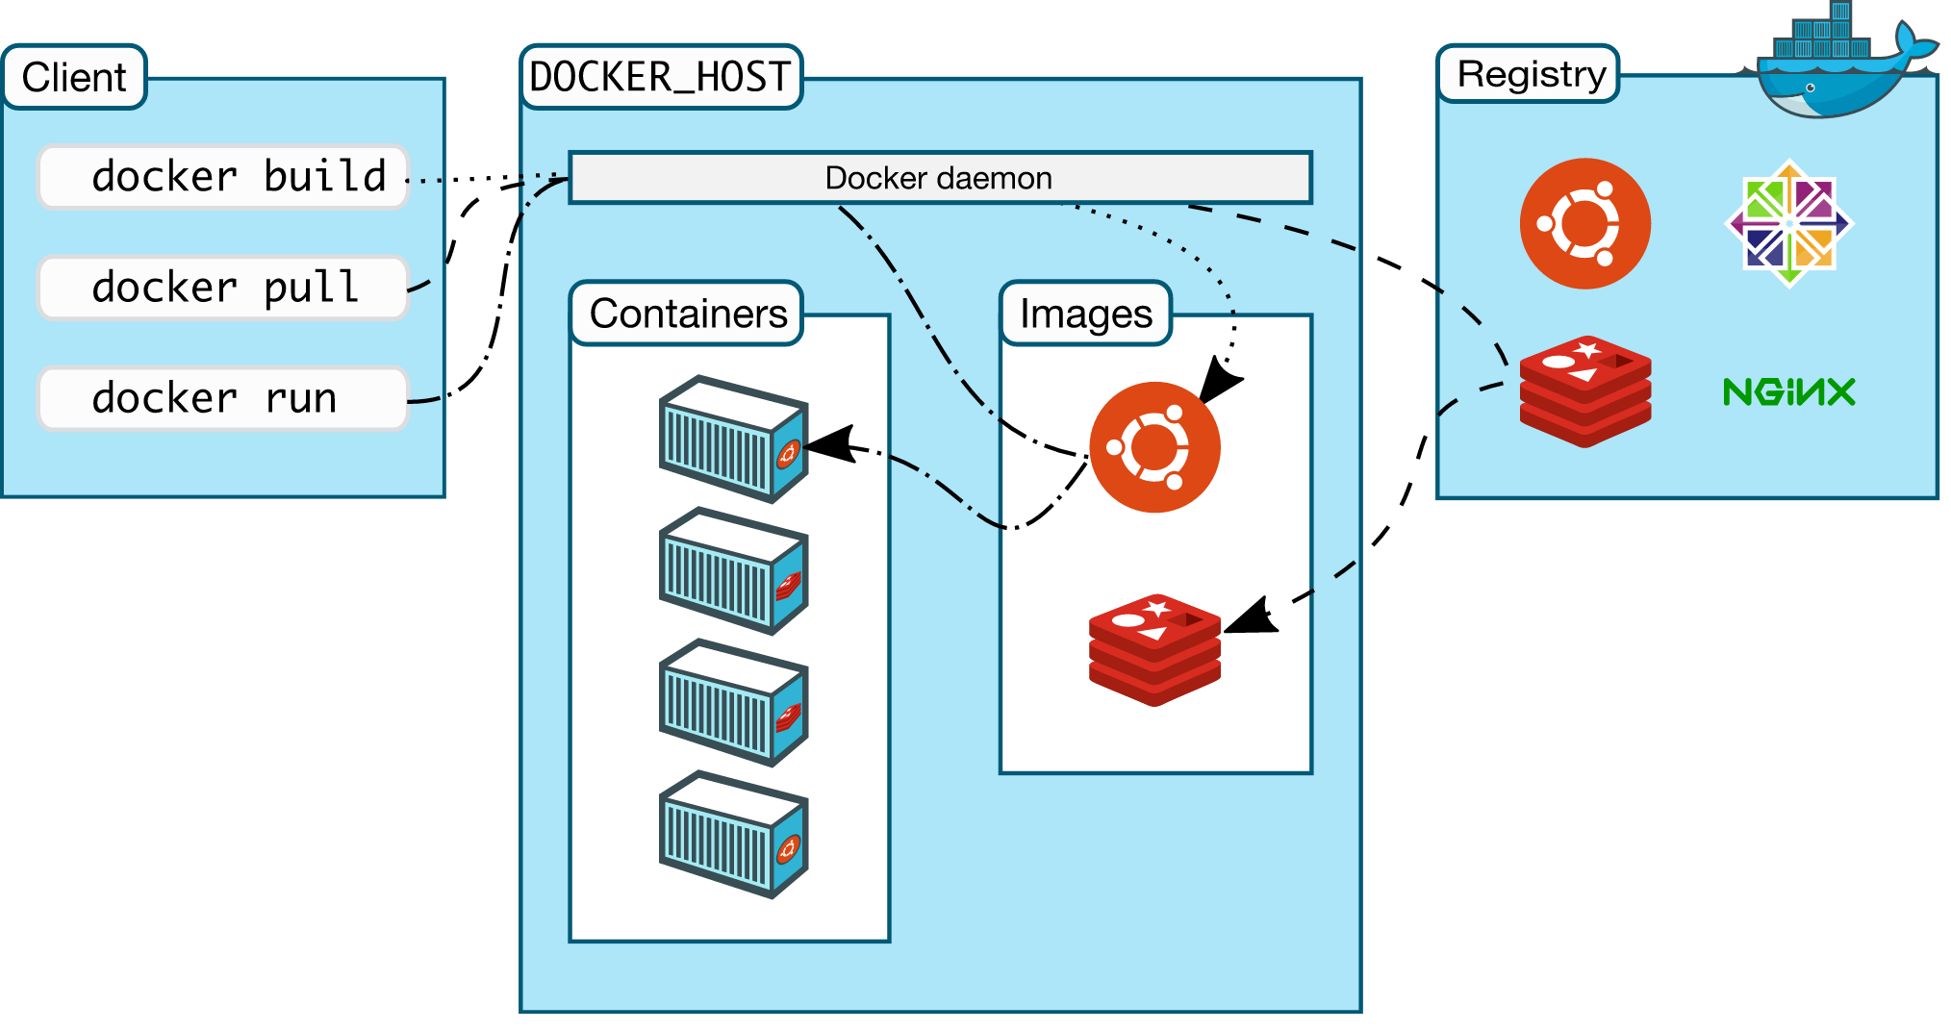

Slide 8
Dockerfile commands
Commands | Description
FROM | To specify the parent image.
WORKDIR | To set the working directory.
RUN | To set the working directory.
COPY | To copy over files or directories from a given location.
ADD | Handles URLs and unpack compressed files.
ENTRYPOINT | Command that will always be executed when we run the container.
CMD | Arguments passed to the entrypoint.
EXPOSE | Defining the port to access our container application.
LABEL | Add metadata to the image.

Slide 9
We’ll learn about deployment through a demonstration later

Slide 10
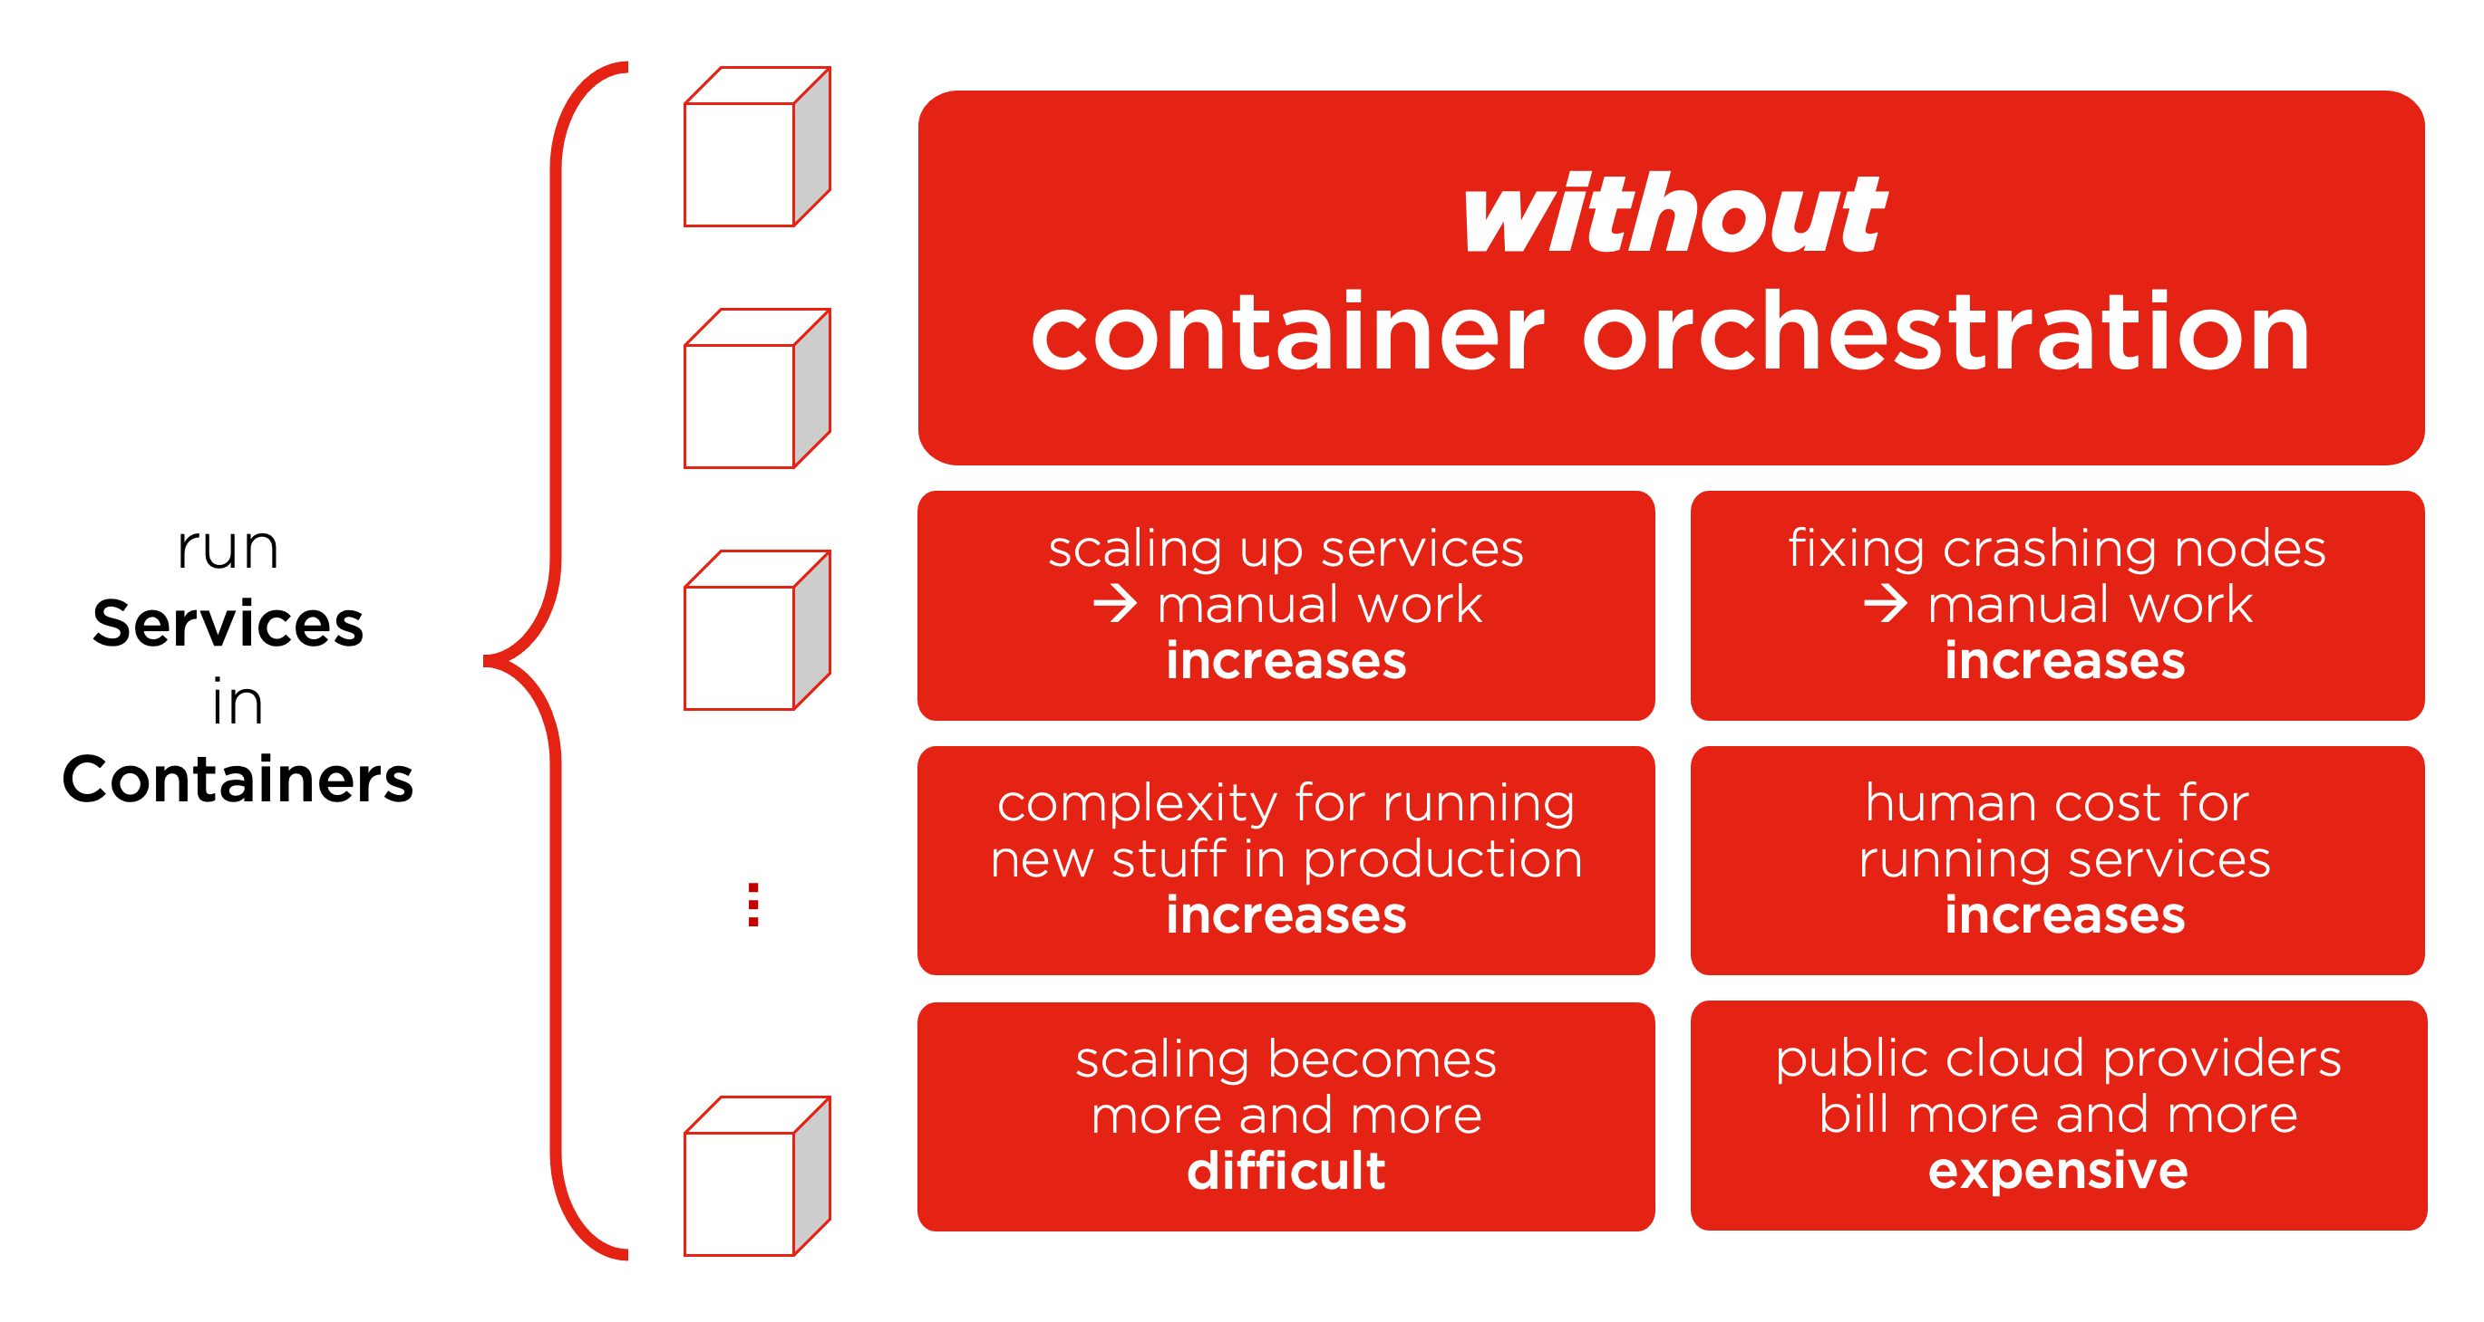
Orchestration
Source: Exoscale

Slide 11
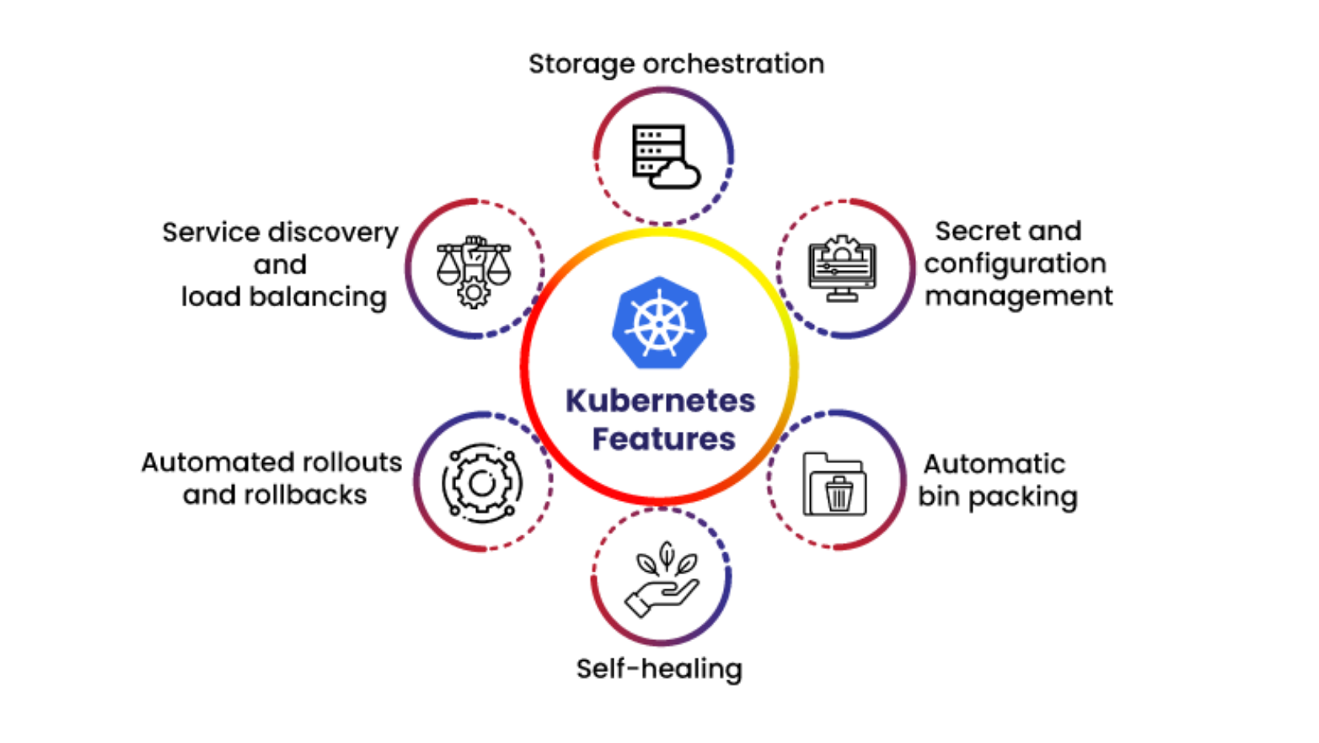
Advantages of Orchestration
Source: Cloud Stack Group

Slide 12
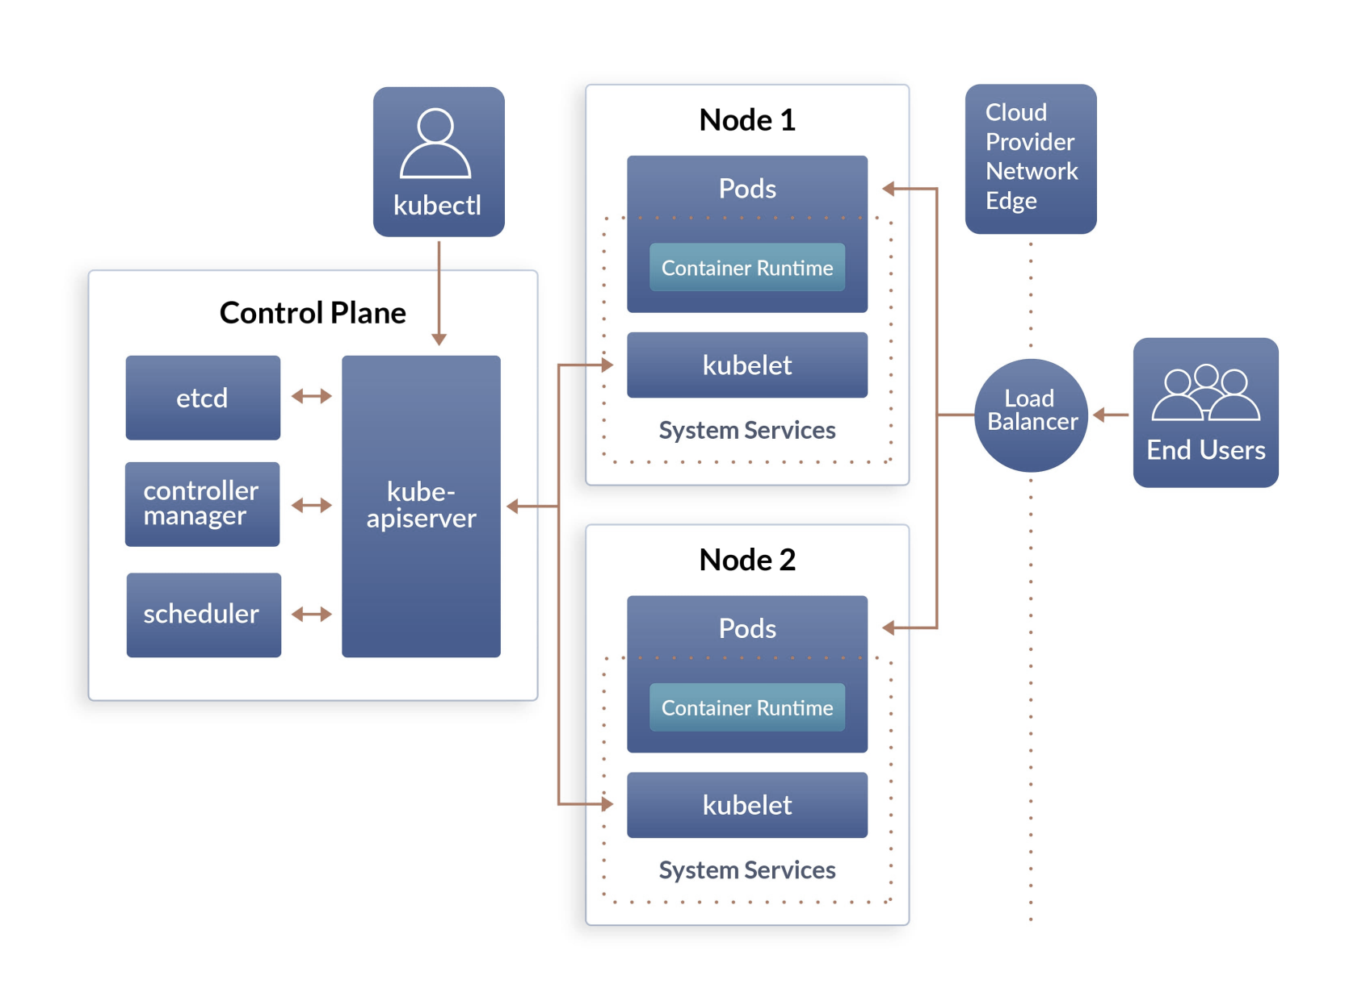
Kubernetes Architecture
Source: Quintagroup

Slide 13
Kubernetes application deployment
$ kubectl run torch_ex --image=root/dockerimages/torch_ex :v1 --port=3000
deployment "my-app" created
Use this command to pull and run your docker image
$ kubectl get pods
NAME READY STATUS RESTARTS AGE
Torch_Ex 1/1 Running 0 05m
$ kubectl expose deployment torch_ex --type=LoadBalancer --port=8080 --target-port=3000
service "my-app" exposed
$ kubectl get svc
NAME TYPE CLUSTER-IP EXTERNAL-IP
torch_ex LoadBalancer 10.12.365.196 281.176.15.13

Slide 14
Kubernetes application deployment
$ kubectl set image deployment/torch_ex torch_ex=root/dockerimages/torch_ex:v2
Automated Rolling Update to the K8s cluster
$ kubectl delete deployment my-app $ kubectl delete svc my-app

Slide 15
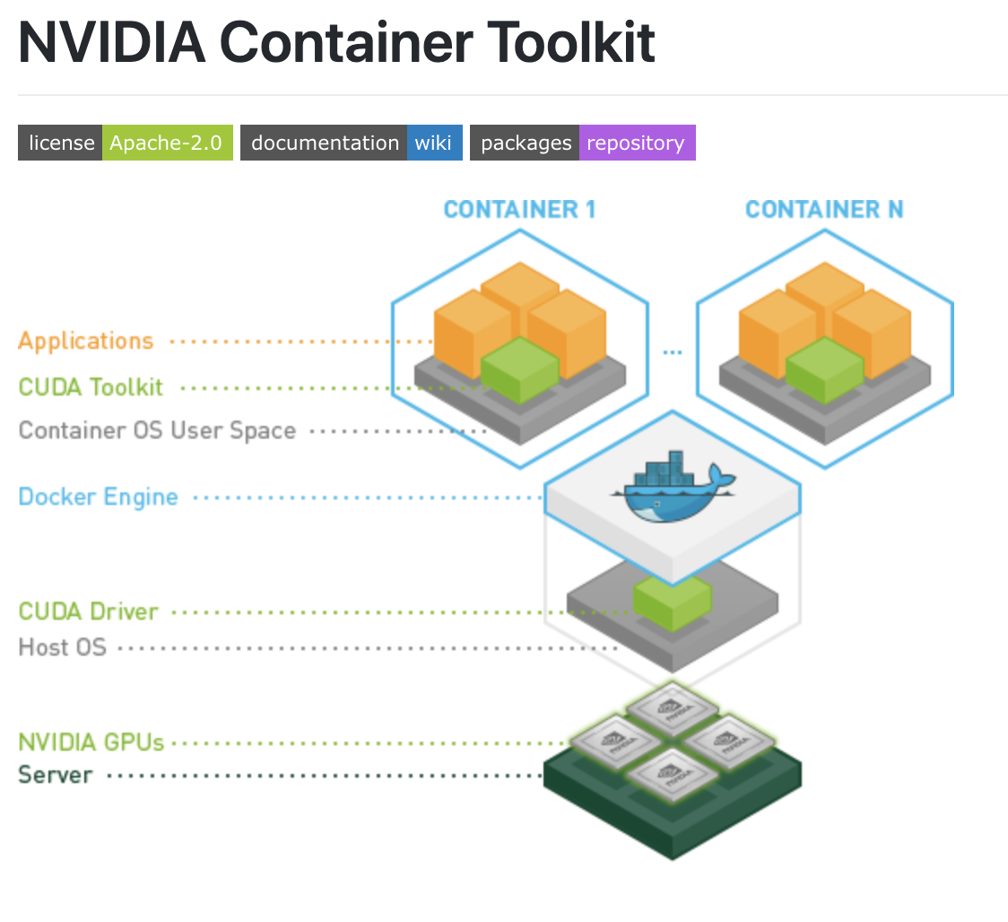
Source: Nvidia

Slide 16
Multi-GPU Training using PyTorch
Data Parallel
Distributed Data Parallel
Model Parallel
Automated – lightning or elastic torch

Slide 17
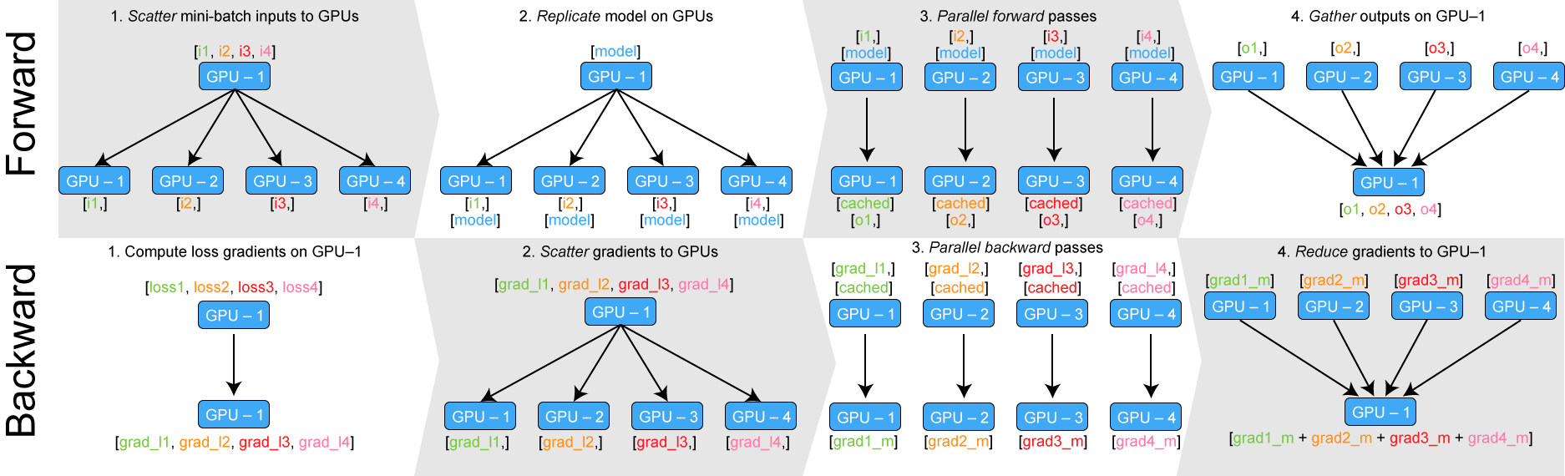
Data Parallel using PyTorch

Slide 18
Pytorch Lightning https://pytorchlightning.ai/
Refactors the code for automated training on multiple GPUs
$docker pull pytorchlightning/pytorch_lightning
Advantages:
Run your code on any hardware
Performance & bottleneck profiler
Model checkpointing
16-bit precision
Run distributed training
Logging
Metrics
Visualization
Early stopping etc.,

Slide 19
Topics Covered in this discussion
Theory
Instructions
Problems with traditional ML training & deployment
Containerization
Docker Architecture
Docker Components
Orchestration
Kubernetes Architecture
Scaling up with Kubernetes- Application Deployment
Nvidia Container toolkit for GPU Training
Multi-GPU Training on PyTorch
Automatic Scaling up of models on GPUs using PyTorch Lightning
Setting up and running a docker container to train a CNN model
Adding GPU Configuration using Nvidia Container Toolkit

Slide 20
Instructions to build docker containers & integrate with Nvidia Container Toolkit

Slide 21
Explore More!!
Containerization & orchestration is such a wide topic that needs a semester long course to master
Start exploring
various docker setups,
deploy more ML applications using docker
Orchestrate the K8s using ML model in cloud services like Google Kubernetes Service or Amazon EKS (they support free trials ☺)
Client-Server architecture based live deployment of a CNN model

Slide 22
THANK YOU

